Slide 1
RESIDENTIAL GARAGE ADDITION
CENE 486C Presentation
Hawkeye Engineering
Team Members : Alhawraa Alhosaini, Daliza Jeffrey, and Garrett Chott
Technical Adviser: Jaclyn Zibrat, E.I.T
Instructor : Mark Lamer, P.E.

Slide 2
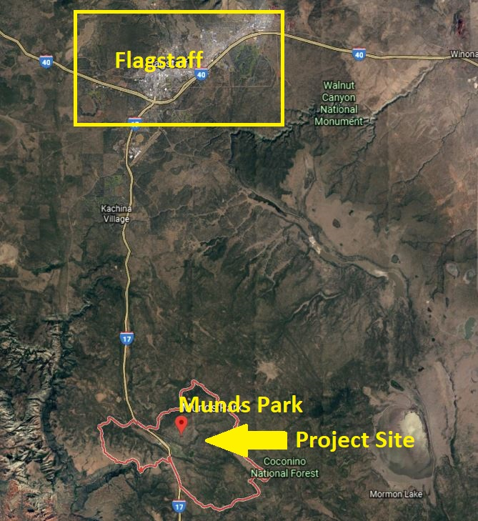
Project Background
Mark Haven’s home is located in Munds Park, Coconino County [1].
Primary concerns: Residence has no garage; Vehicles not accessible during winter
Secondary concerns: Residence is lacking space for storage or client’s photography interests
Figure 1: Location of Munds Park & Project Site [1]
Alhawraa,2
Notes:
(it is a residential manufactured home, approx 6,000 sq ft)
Stakeholders: Mark Haven, the contractor hired to build the garage, and the people who live in Mark Haven’s neighborhood

Slide 3
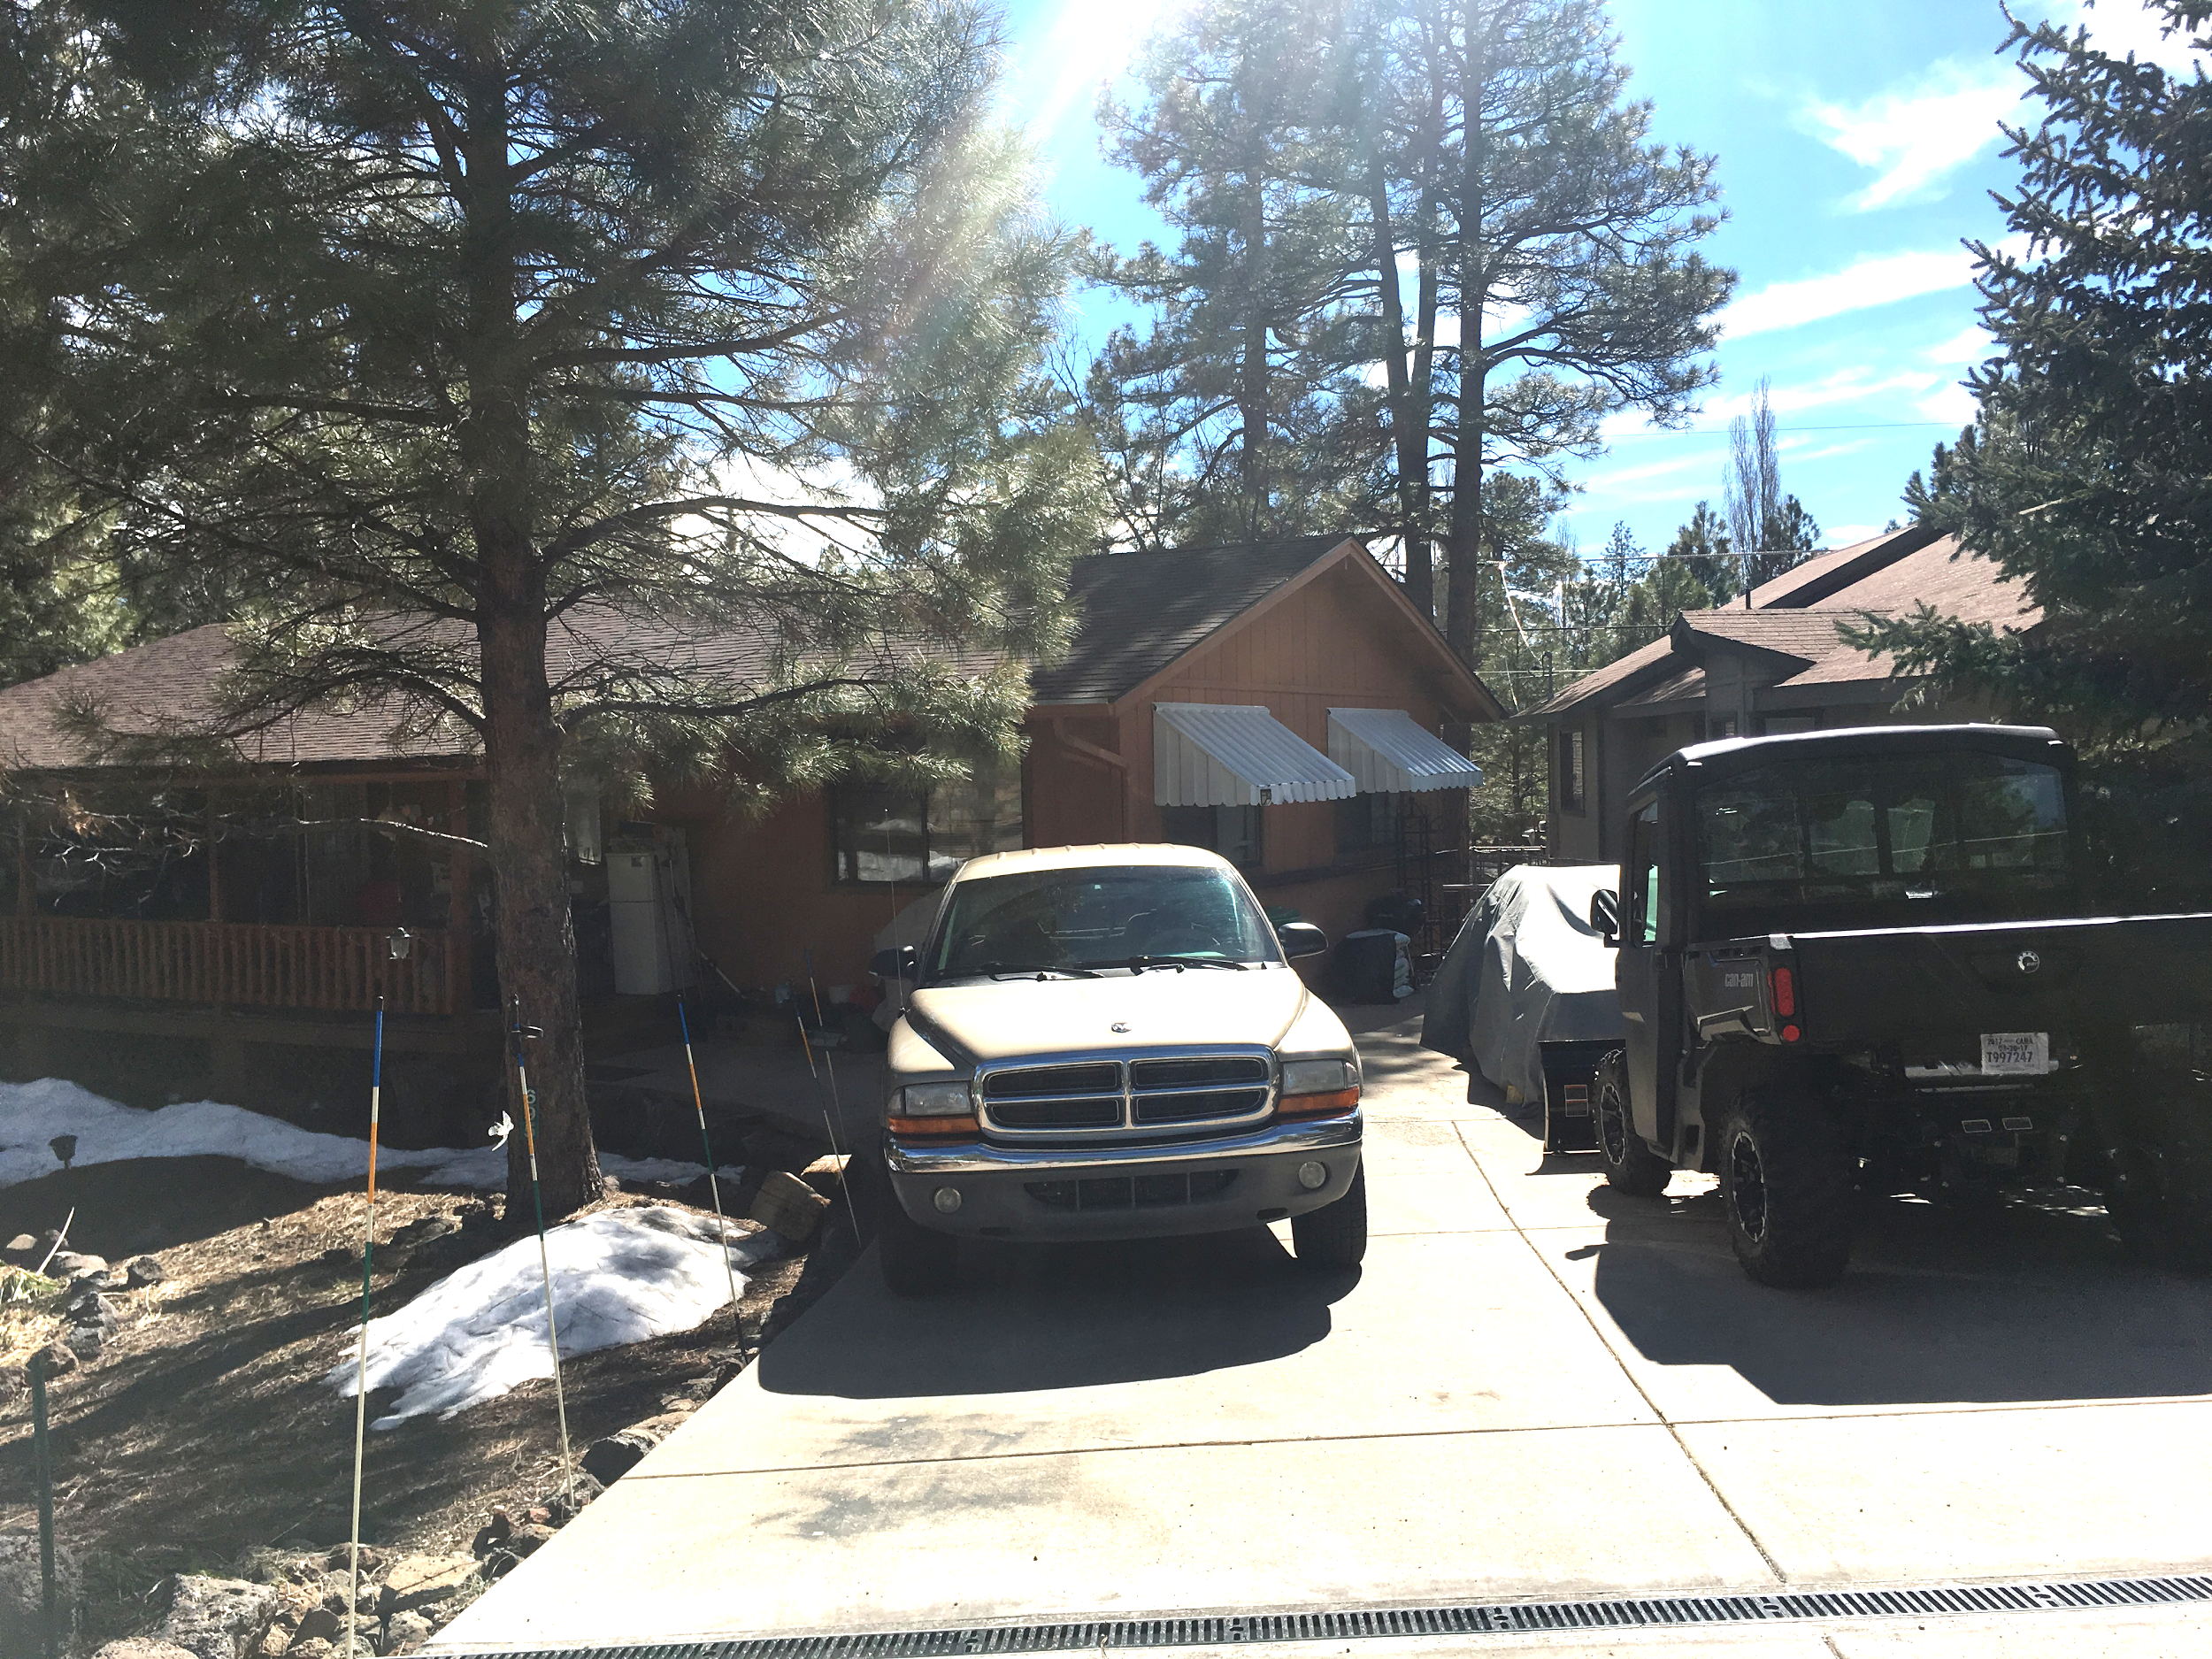
Project Understanding
Criteria
Two story, attached garage
Accessible during snowstorms
Second floor for photography studio and/or storage
Constraints
Can not alter existing landscape
20’ setback and 5’ easement leaves minimal area for design[2]
Figure 2: Mark Haven’s Residence (Front view)
Alhawraa, 3
Notes:
Setbacks on Pg 35 of Zoning Ordinance

Slide 4
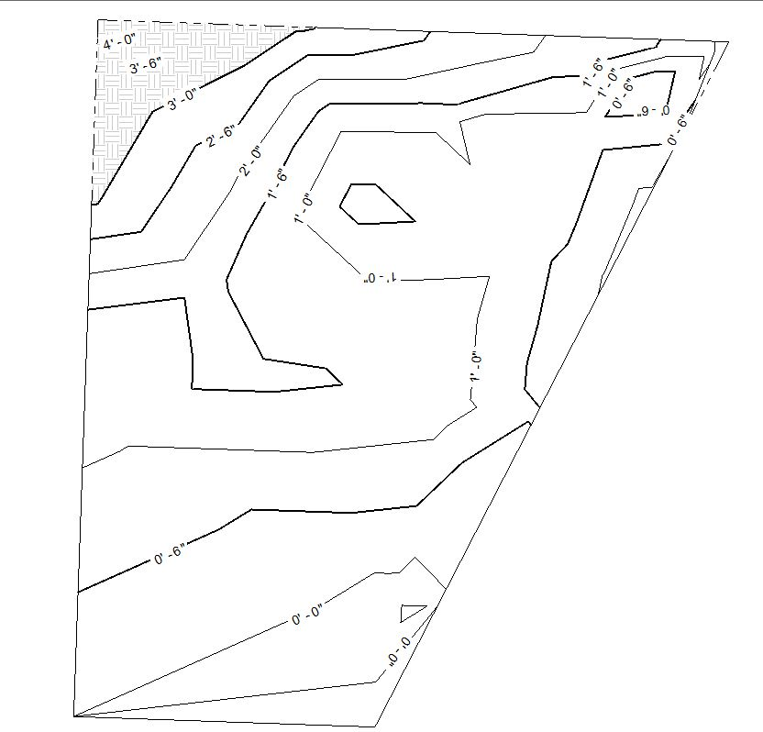
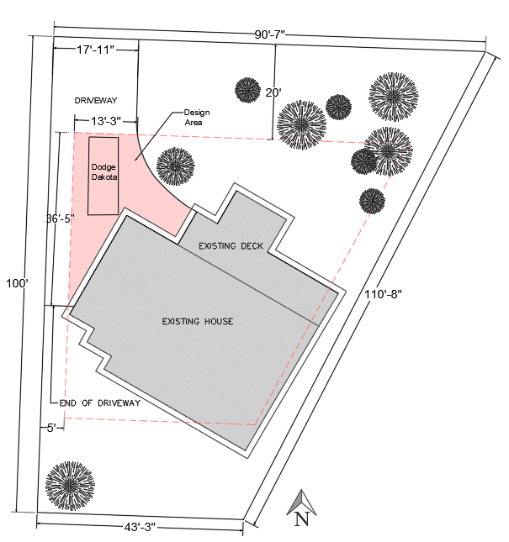
Surveying and Mapping
Surveying and Site Analysis results:
Front and side setbacks meet the requirements of Coconino County Zoning Ordinance for garage building (20’ and 5’ respectively)
Determined property boundaries and driveway dimensions
Determined where the existing house is located on the lot
Figure 4: Contour Map of the Property
Figure 5: Mark Haven Residential Site plan
Alhawraa,4

Slide 5
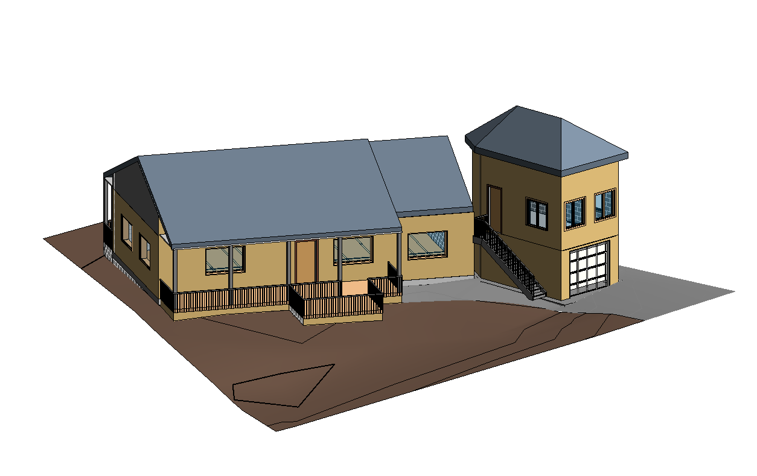
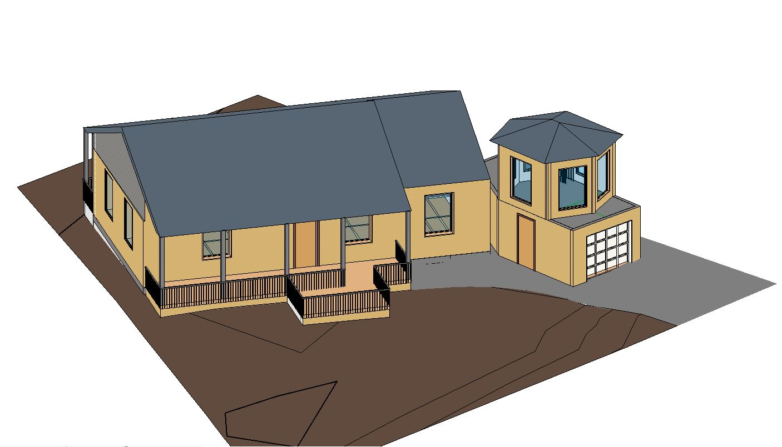
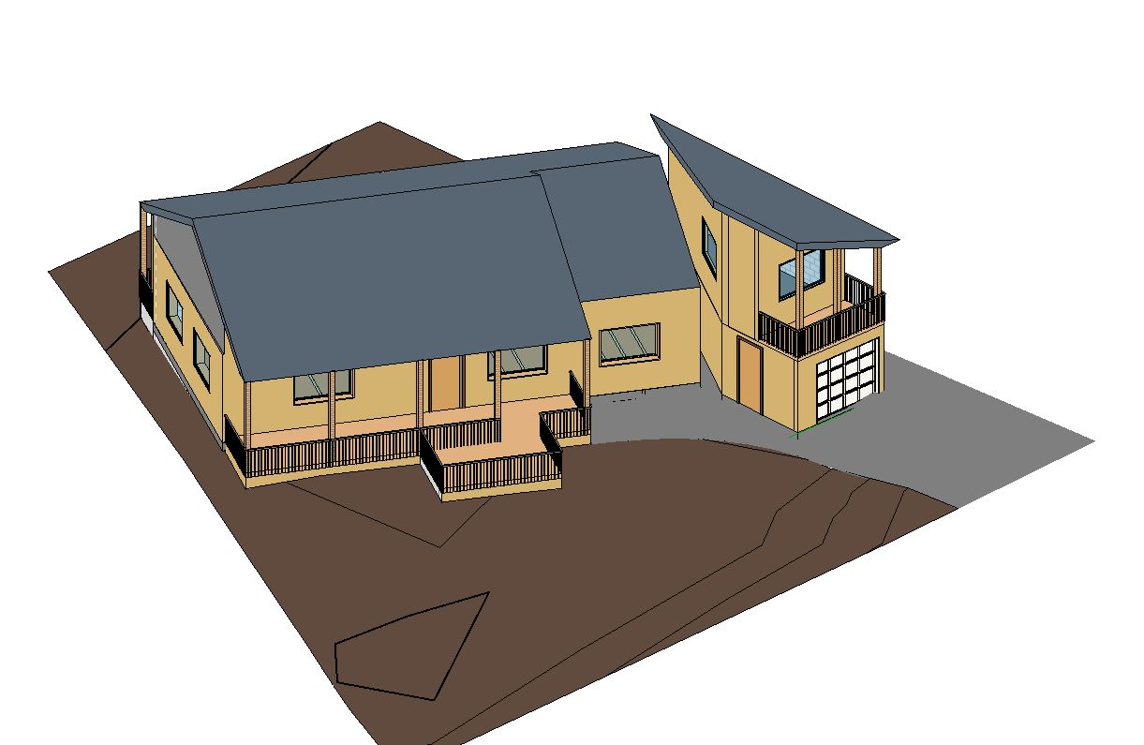
Design Alternatives
Figure 8 :hexagonal shaped design.
Figure 6: Hip roof design.
Figure 7: Single pitch roof design [8] .
Alhawraa,5

Slide 6
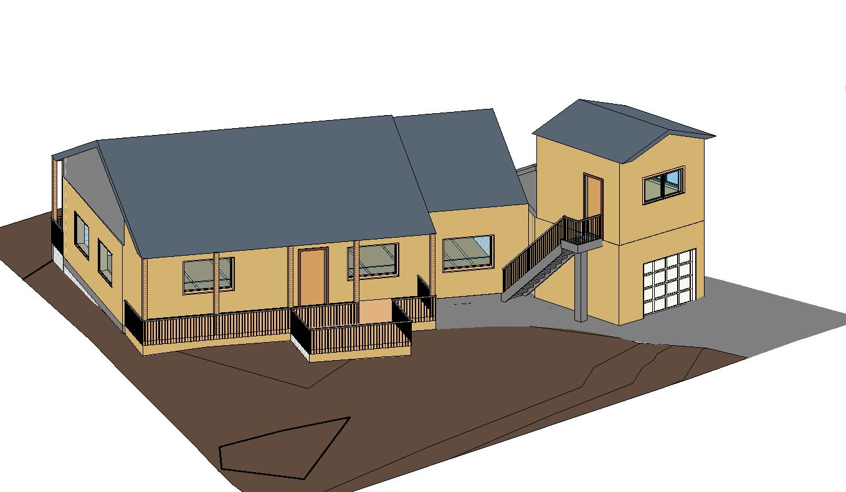
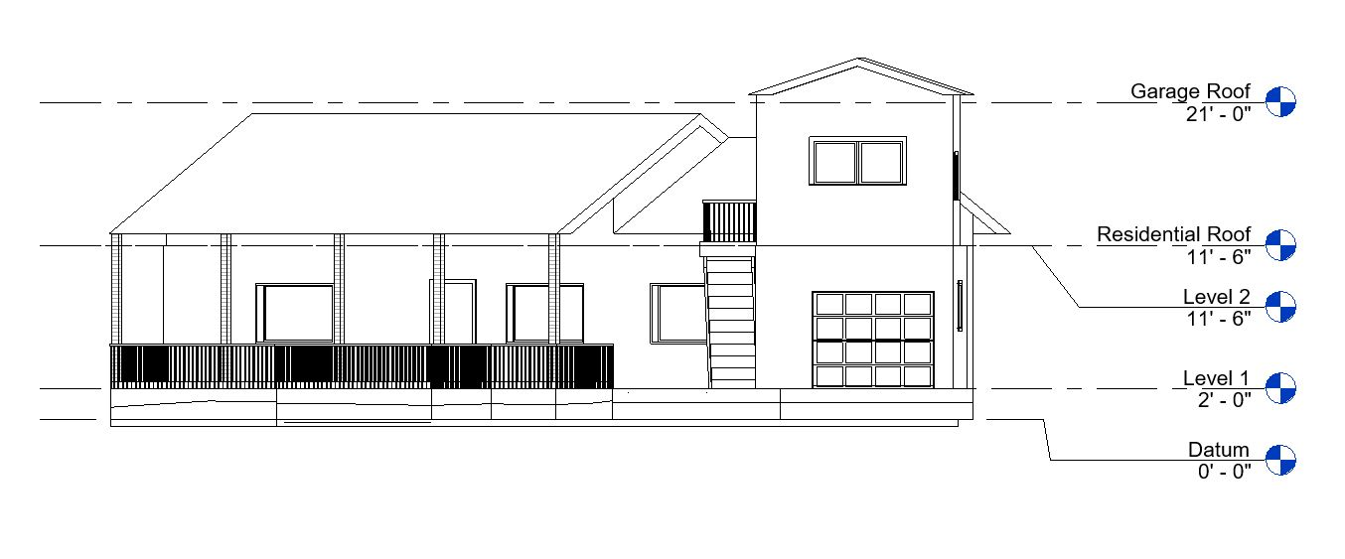
Final Design
  2ft. x 3 ft. area for future elevator in the northeast corner of the building
Exterior staircase
13’ by 13.5’ second story with windows on North, East, and South walls
Selected design due to client’s requirements and limited area
Figure 9: Final design.
Figure 10: Final design elevations.
Alhawraa,6

Slide 7
Gravity Load Determination
Table 1: Roof Design Loads
Loading | Values
Total Roof Dead Load | 18.6 psf
Balanced Snow Load | 46.2 psf
Snow Drift Load | 40.8 psf
Upward Wind Pressure | -23.8 psf
Downward Wind Pressure | 9.70 psf
Table 2: Interior Joist Design Loads
Loading | Values
Floor Dead Load | 25.6 psf
Floor Live Load | 40.0 psf
Table 3: Gable Roof Design Loads
Loading | Values
Total Roof Dead Load | 18.6 psf
Balanced Snow Load | 46.2 psf
Upward Wind Pressure | -23.8 psf
Downward Wind Pressure | 9.70 psf
Garrett,7
Notes:
Gravity loads determined with ASCE 7-10 [10]. Weights of materials (provided by ASCE 7-10) to determine dead load, Tributary widths determined, Uplift of wind considered

Slide 8
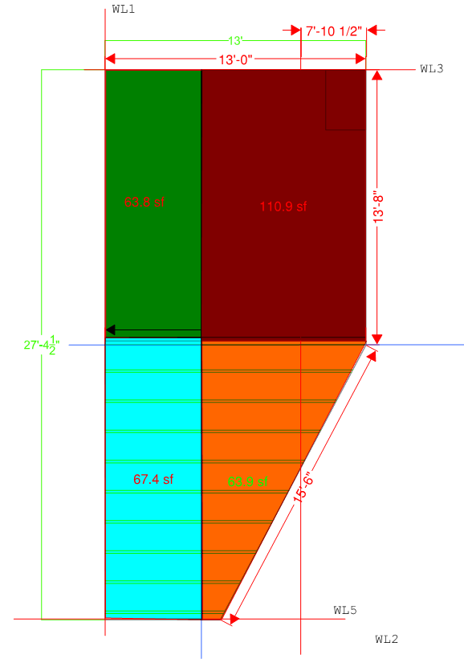
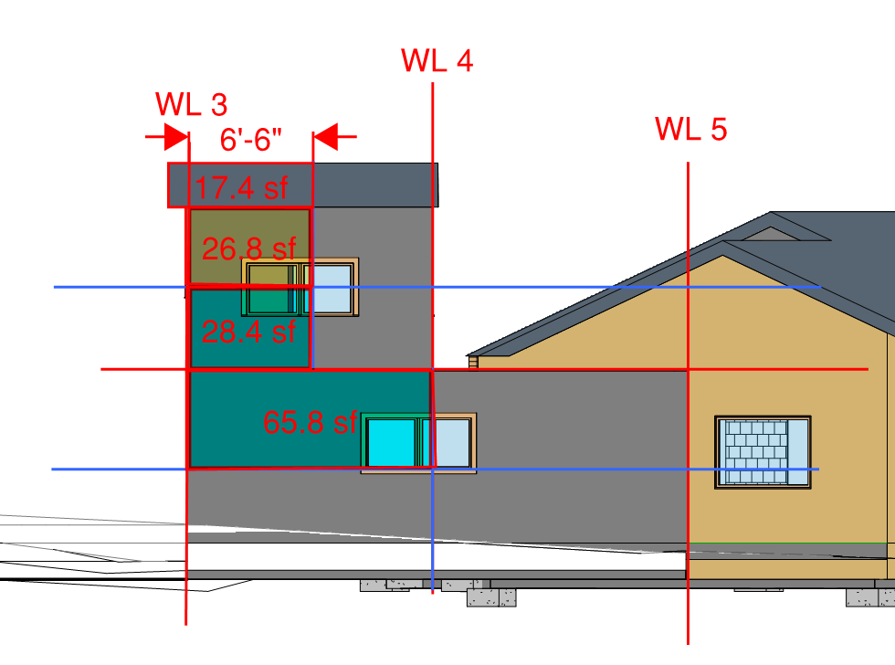
Lateral Load Determination
Lateral loads determined by hand and with values from ASCE 7-10 [10].
Wind and seismic loading both considered
Table 4: Lateral Loading Summary
Loading | Maximum Value
Seismic Loading | 748 lbs
Wind Loading | 2138 lbs
Figure 11: Wind Load Path
Figure 12: Seismic Loading
Garrett,8

Slide 9
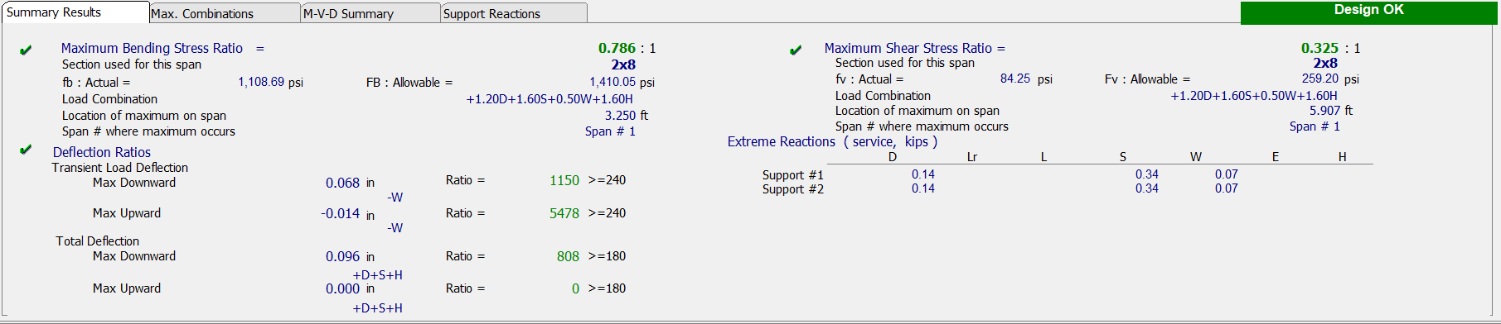
Structural Analysis
Load combination equation
Figure 13: Summary of wood beam design results
Structural Design completed with Enercalc structural design software [13].
Optimized for most effective and inexpensive design with mostly locally available materials
Garrett,9

Slide 10
Building Components
Table 5: Beam/Joist Schedule
Item | Specification | Quantity
Flat Roof Beam | 3 2”x12” | 1
Ridge Beam | 5.125”x10.5” Glulam | 1
Gable Roof Joist | 2”x8” | 20
Interior Joist | 2 2”x10” | 9
Flat Roof Joist | 2”x12” | 9
Table 6: Column Schedule
Item | Specification | Quantity
1st Story Stud | 2”x6” | 73
2nd Story Stud | 2”x6” | 34
1st Story Column | 3”x6” | 1
Ridge Beam Support | 3 2”x6” | 1
Table 7: Header Schedule
Item | Specification | Quantity
Window | 2 2”x10” | 4
Door | 2 2”x8” | 2
Garage Door | 2”x10” | 1
Garrett,10

Slide 11
Building Components
Table 9: Shear Wall Schedule
Item | Thickness | Nail spacing/type | Quantity
Upper SW1 | 5/16” | 6D nails at 6” O.C | 1
Lower SW1 | 5/16” | 6D nails at 6” O.C | 1
Upper SW2 | 5/16” | 6D nails at 6” O.C | 1
Lower SW2 | 5/16” | 6D nails at 6” O.C | 1
Upper SW3 | 15/32” | 8D nails at 6” O.C | 1
Lower SW3 | Simpson Strong Wall WSW 12X7 | 8D nails at 6” O.C | 2
Lower SW5 | 15/32” | 6D nails at 6” O.C | 1
Table 8: Connection Schedule
Item | Specification | Quantity
Flat Roof Beam | LUS210-3 | 2
Flat Roof Joist | LUS210 | 18
Gable Roof Joist | LUS26 | 40
Beam to Column | H2.5a | 4
Garrett,11

Slide 12
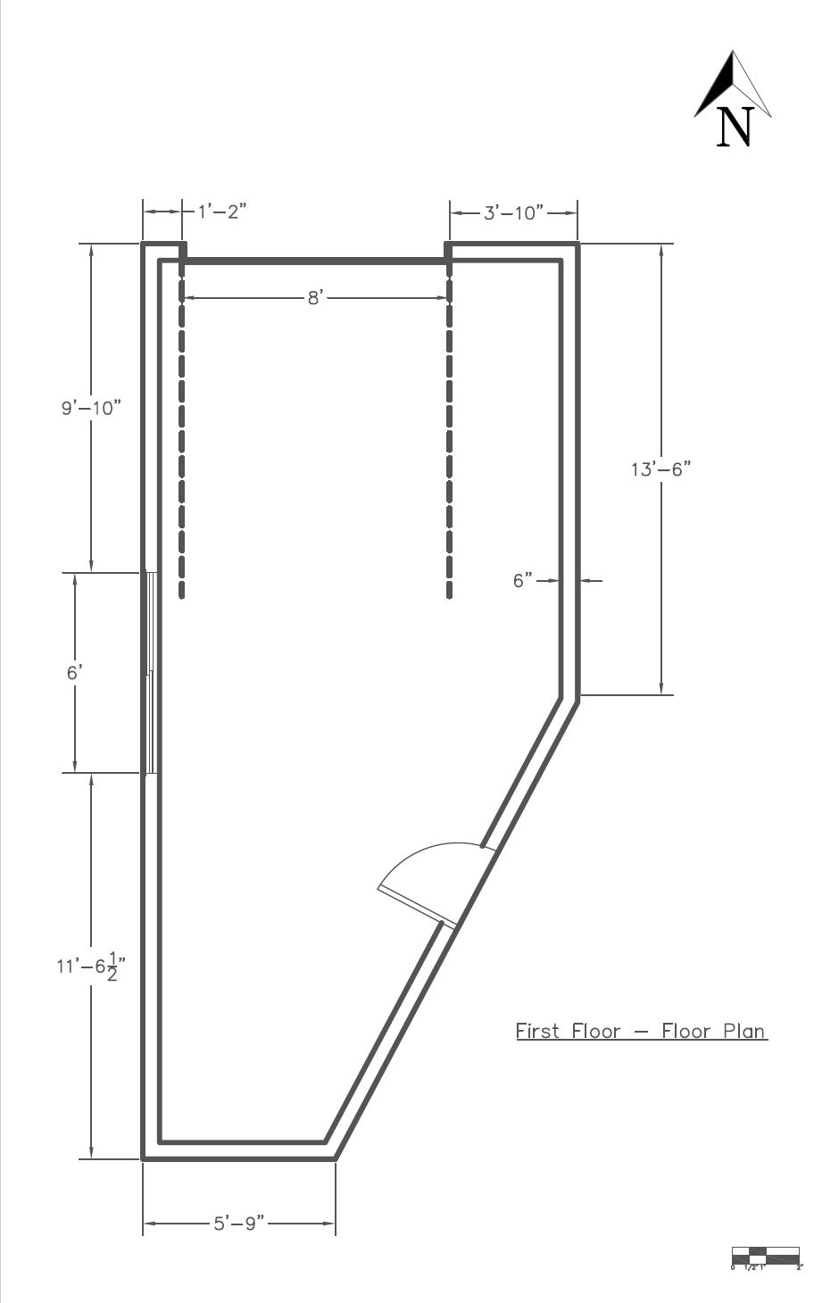
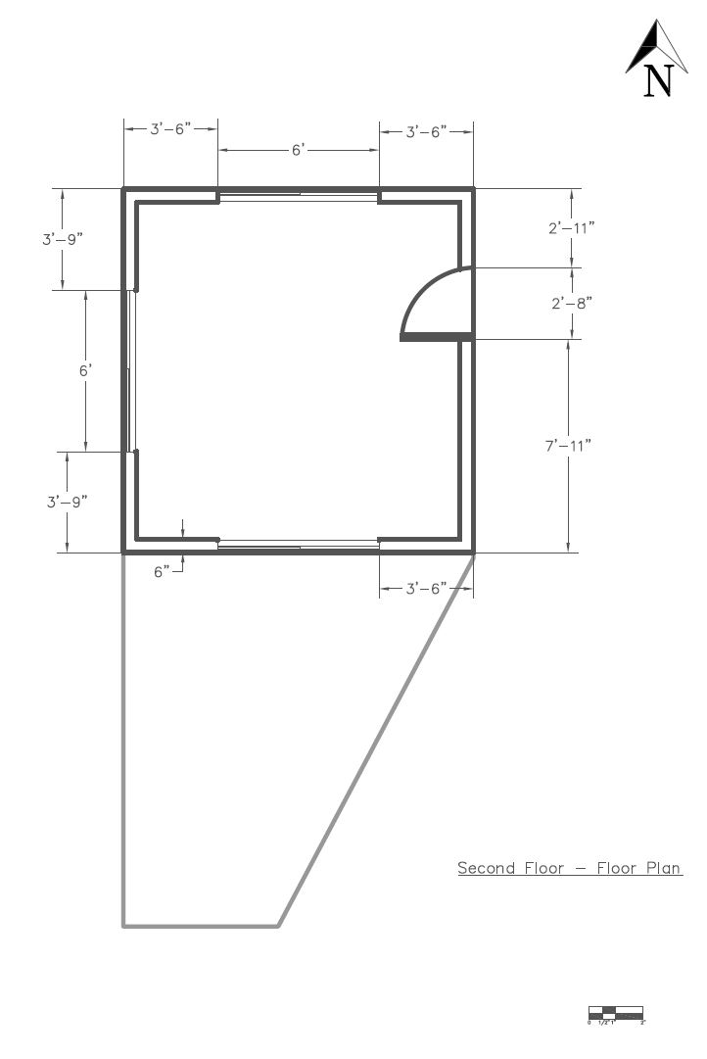
Construction Documents: Floor Plan
Figure 14: 1st Floor Plan
Figure 15: 2nd Floor Plan
Daliza,12

Slide 13
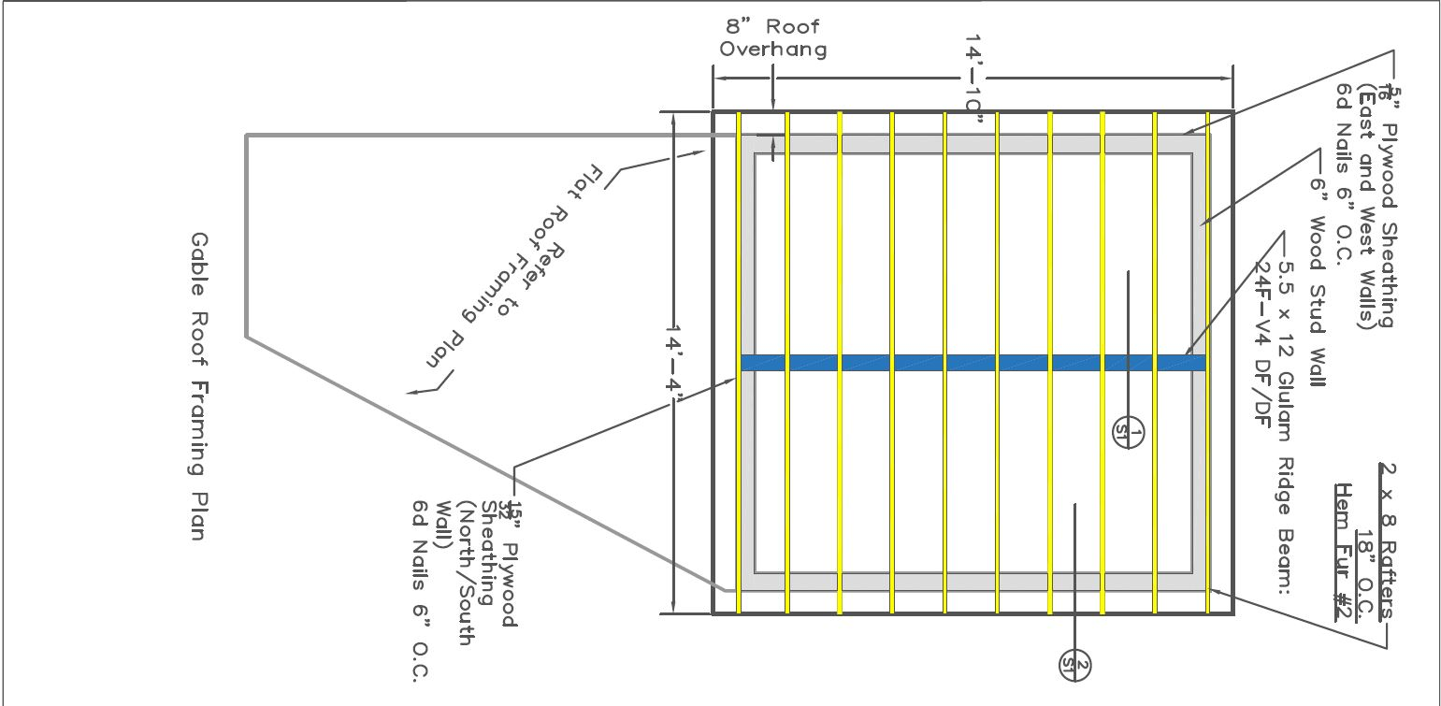
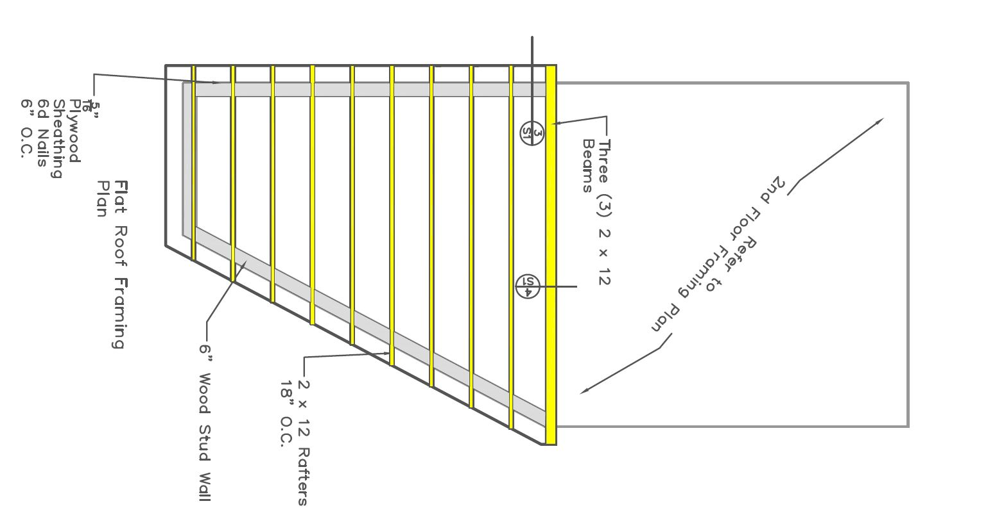
Construction Documents: Roof Framing
Rafters/Beams
Ridge Beam
Stud Wall
Figure 16: Gable Roof Framing
Figure 17: Flat Roof Design
Daliza,13

Slide 14
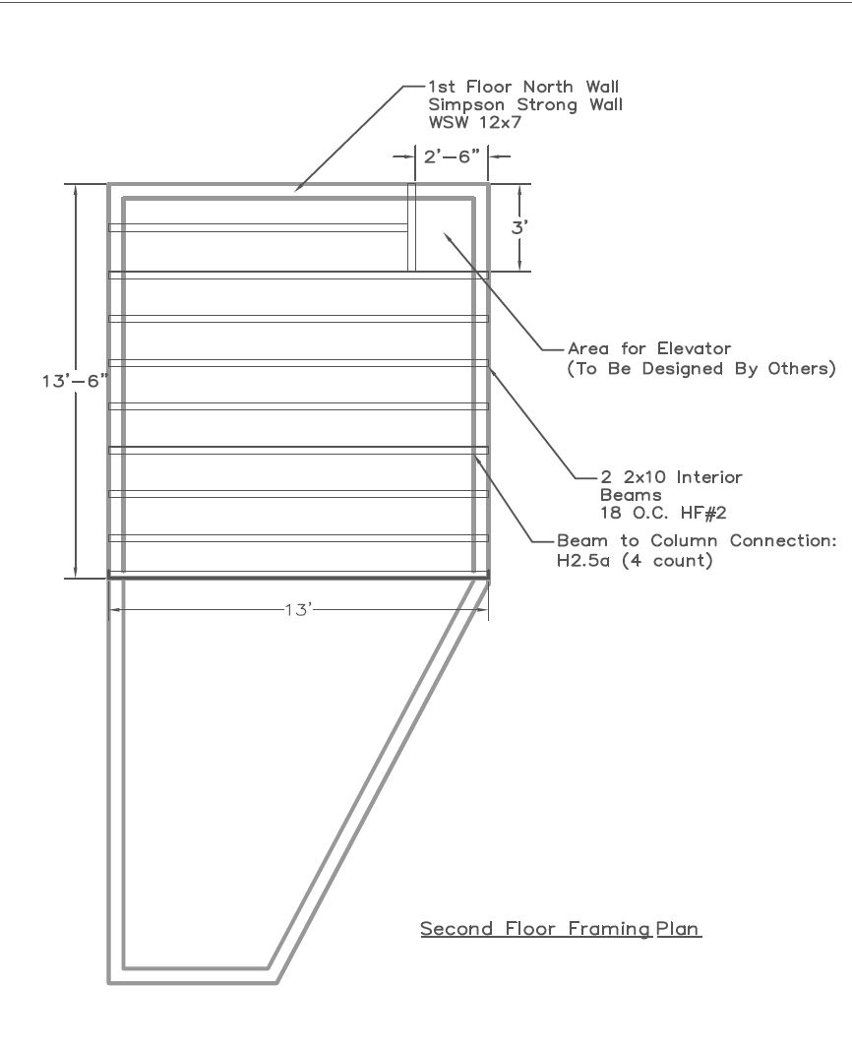
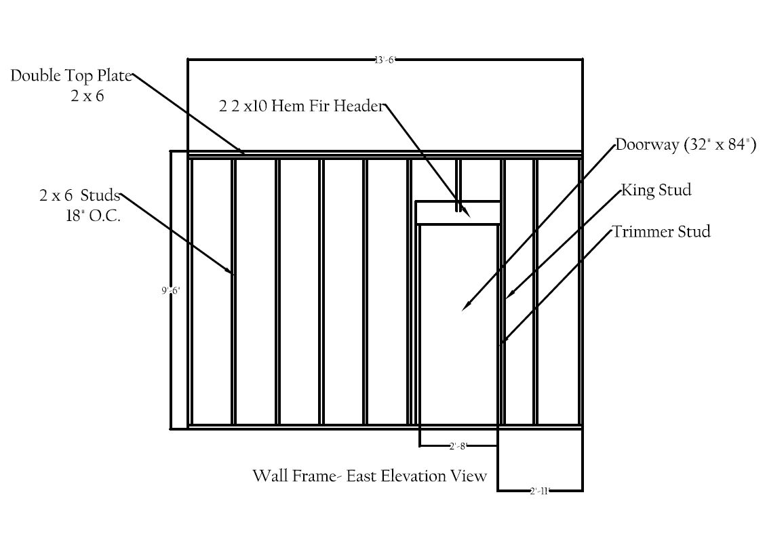
Construction Documents: Wall & Floor Framing
Figure 18: Wall Framing
Figure 19: Second Floor Framing
Daliza,14

Slide 15
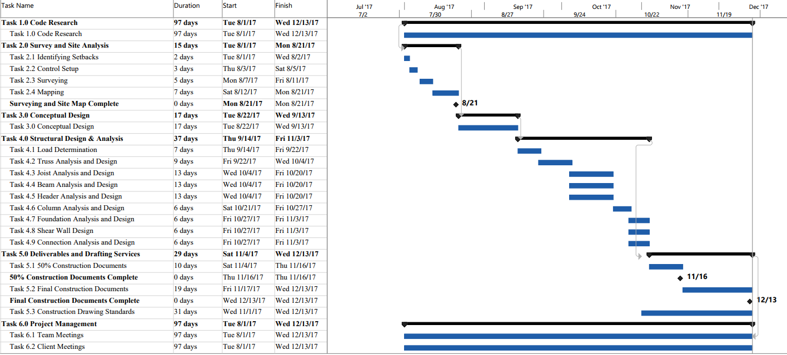
Schedule
Figure 20: Project Gantt Chart
Alharwaa,15

Slide 16
Cost of Engineering Services
Table 10: Cost of Services
 | PM (hr) | SE (hr) | LS (hr) | EIT (hr) | DS (hr) | Cost Actual Labor | Cost Estimate Labor
Billing Rate ($/hr) | $125 | $170 | $60 | $65 | $70
Task 1.0 Survey & Site Analysis | 9 | 0 | 25 | 6 | 20 | $ 4,040.00 | $ 3,805.00
Task 2.0 Conceptual Design | 3 | 4 | 3 | 15 | 25 | $ 3,960.00 | $ 3,080.00
Task 3.0 Structural Design & Analysis | 24 | 120 | 0 | 260 | 0 | $ 40,300.00 | $ 35,830.00
Task 4.0 Construction Docs & Drafting Services | 9 | 2 | 0 | 10 | 105 | $ 9,465.00 | $ 9,465.00
Task 5.0 Project Management | 30 | 0 | 1 | 2 | 3 | $ 4,150.00 | $ 4,360.00
Grand Total |  |  |  |  |  | $ 61,915.00 | $ 56,540.00
Daliza, 16

Slide 17
Cost of Implementation
Daliza,17

Slide 18
“Triple Bottom Line” Impacts
Economic Impact:
Providing jobs in multiple areas
Social and Health Impacts:
Aesthetic acceptance of the design
Accessing to the storage and car during winter
Neighbor's property
Environmental Impacts:
Hem fir wood material requires less energy
Treated wood has higher environmental hazards
Construction energy usage
Alhawraa,18

Slide 19
References
[1] "Munds Park, Arizona," 2017. [Online]. Available: http://www.city-data.com/city/Munds-Park-Arizona.html. [Accessed 07 02 2017].
[2]C. C. Arizona, "Coconino County Zoning Ordinance," 26 07 2016. [Online]. Available: http://www.coconino.az.gov/1212/Applications-Forms-Information [Accessed 27 February 2017].
[3] "Horizontal and Vertical Control," [Online]. Available: http://www.gresurv.com/hvcontrol.html. [Accessed 20 February 2017].
[4] C. D. Ghilani and P. R. Wolf, Elementary Surveying: An Introduction to Geomatics, 13th ed., Upper Saddle River, NJ: Pearson Education Inc., 2012.
[5] C. C. Arizona, “Coconino County Building Ordinance” 26 07 2016. [Online]. Available:http://coconino.az.gov/DocumentCenter/View/12230. [Accessed 27 01 2017].
[6] Coconino County Arizona Community Development, “Residential Plan Submittal Checklist Building Division”; 26 11 2016. [Online]: Available:http://coconino.az.gov/DocumentCenter/View/8839.
[7] R. Chudley and R. Greeno, “Building Construction Handbook” Elsevier, Oxford, 2008.
[8] Autodesk Inc.
[9] Bluebeam Revu
[10] ASCE 7-10 “Minimum Design Loads for Buildings and Other Structures (7-10, Third Printing).” American Society of Civil Engineers (ASCE), 2010, www.asce.org/templates/publications-book-detail.aspx?id=6725.
[11] IBC 2012 “International Building Code, 2012.” Table of Contents | ICC PublicACCESS, 2012, codes.iccsafe.org/public/document/toc/353/.
[12] NDS, Leesburg: American Wood Council, 2012.
[13] ENERCALC," ENERCALC, 2016. [Online]. Available: http://enercalc.com/. [Accessed 23 October 2017].
[14] Construction Business & Technology Conference - Shear Wall Basics", Mcvicker.com, 2017. [Online]. Available: http://www.mcvicker.com/vwall/page013.htm. [Accessed: 01- Dec- 2017].
[15] Construction Business & Technology Conference - Shear Wall Basics", Mcvicker.com, 2017. [Online]. Available: http://www.mcvicker.com/vwall/page013.htm. [Accessed: 30- Nov- 2017].
19

